Slide 1
E Bike
Why purchase our E-ST 500 V2?

Slide 2
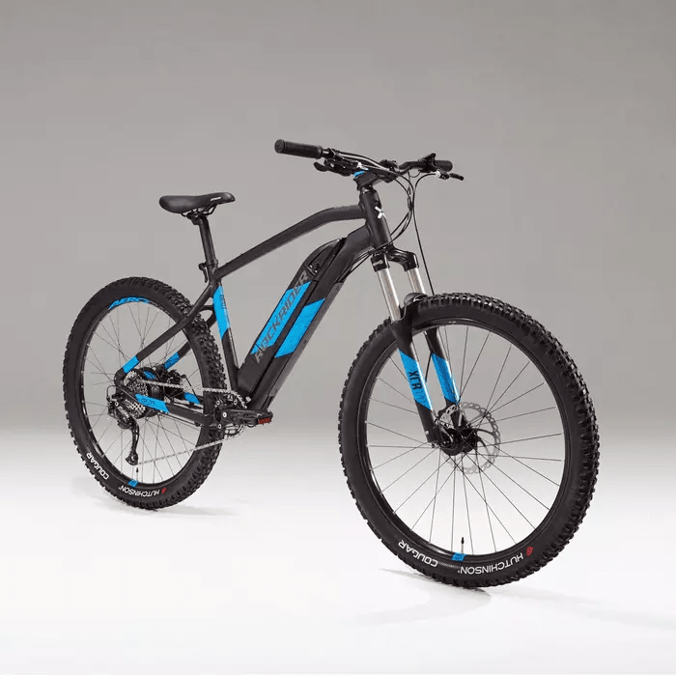
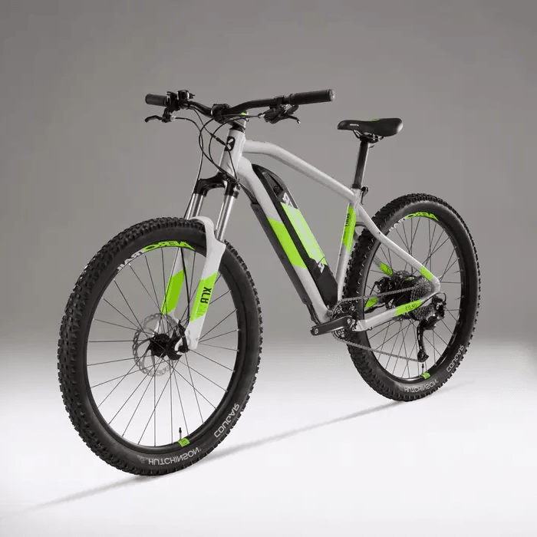
2 Colors
Black / Mediterranean Blue
Lunar Moon

Slide 3
4 Sizes availables
S
M
L
XL

Slide 4

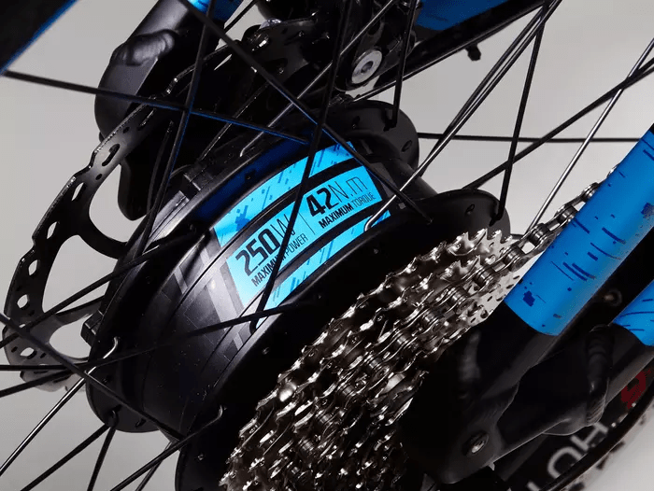
Motor
Power :
250W
Torque :
42Nm

Slide 5
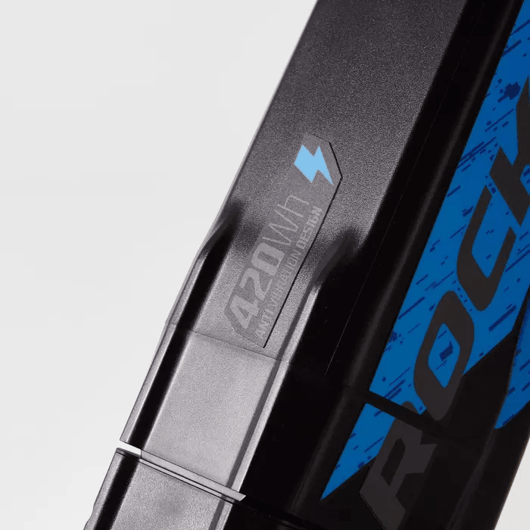
Battery - 420Wh - 36V - 11.6Ah - 2H30 autonomy

Slide 6
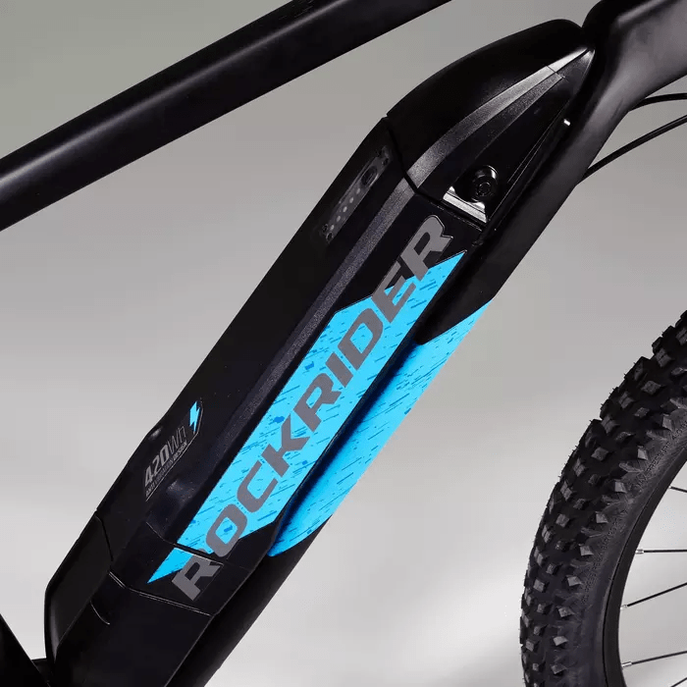
Charge indicator

Slide 7
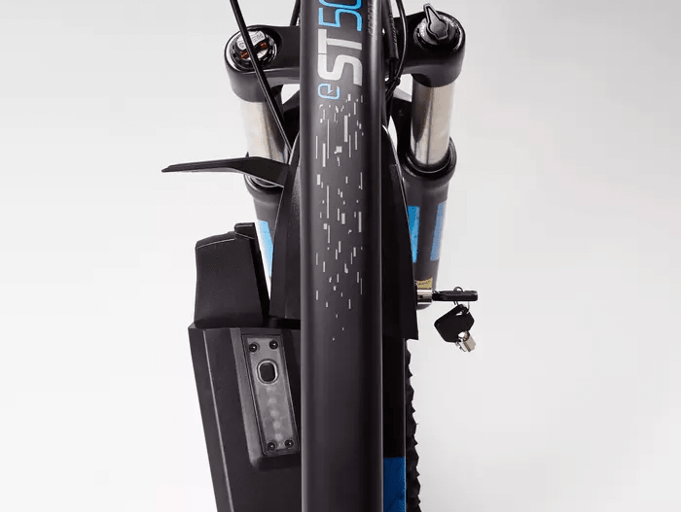
Lockable and Removable battery

Slide 8
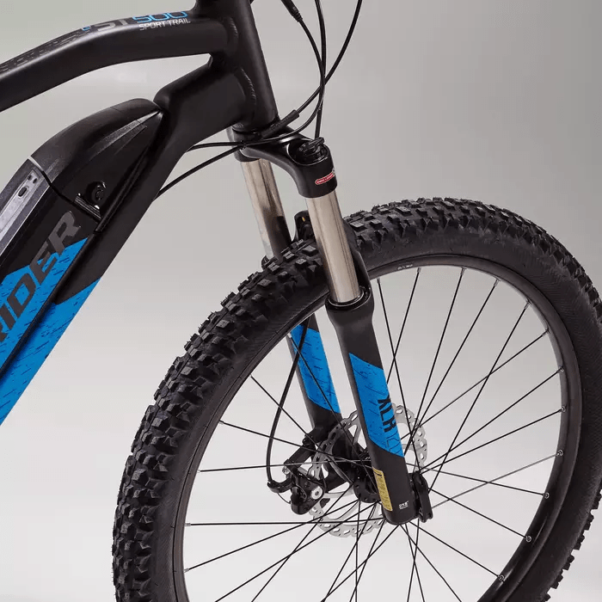
27.5’’ Tires

Slide 9
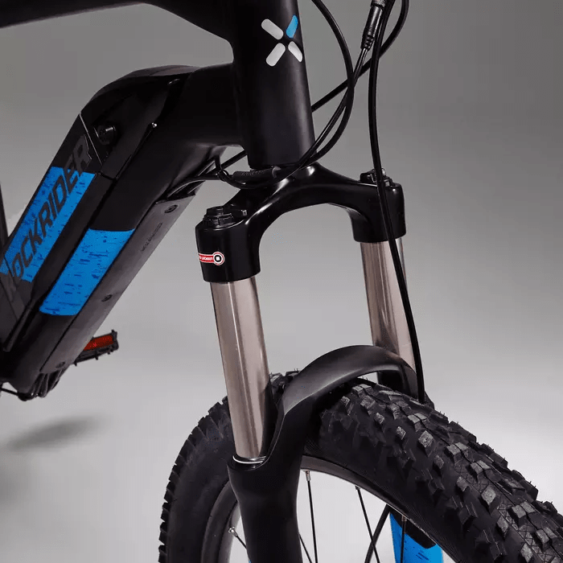
Front Suspension

Slide 10
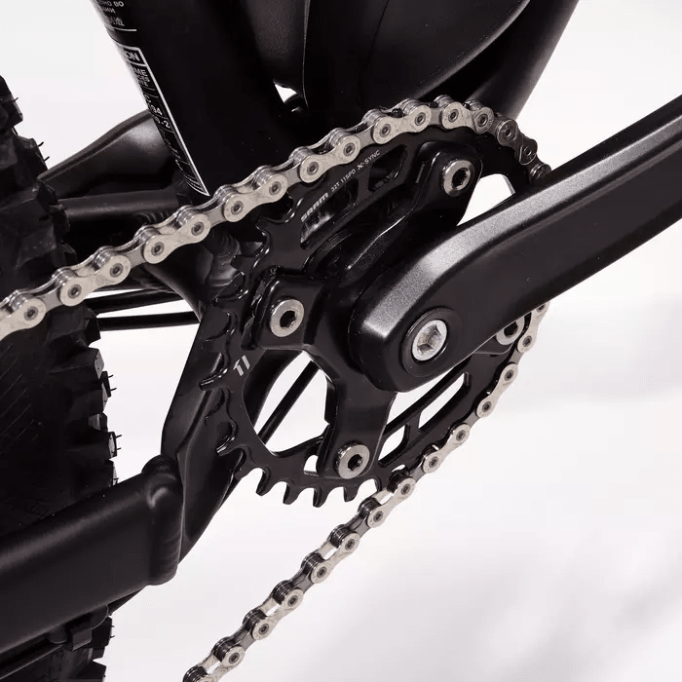
Torque sensor

Slide 11
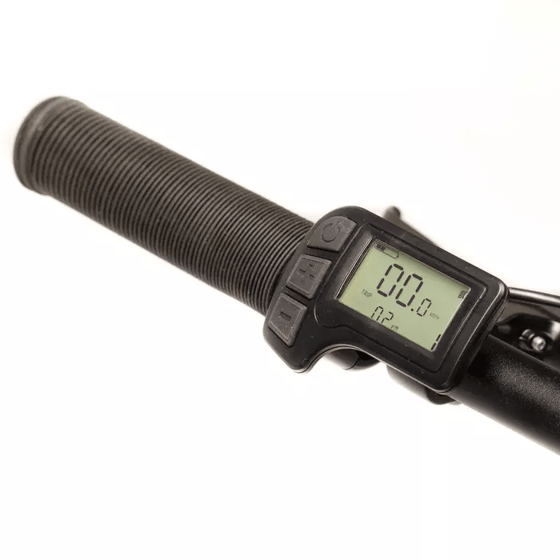
LCD Screen

Slide 12
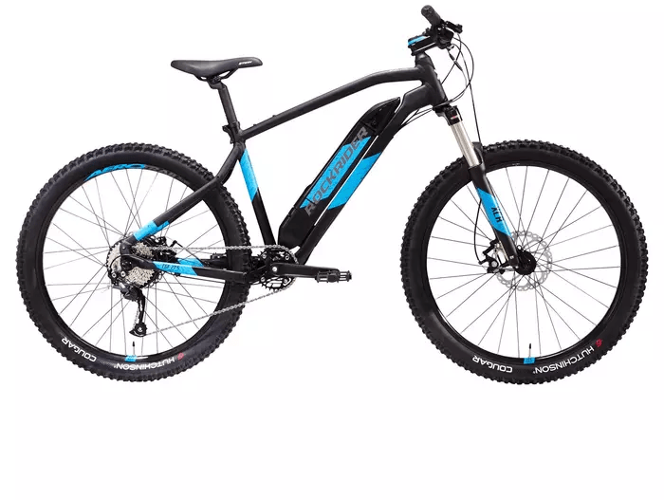
100% Aluminium Frame

Slide 13
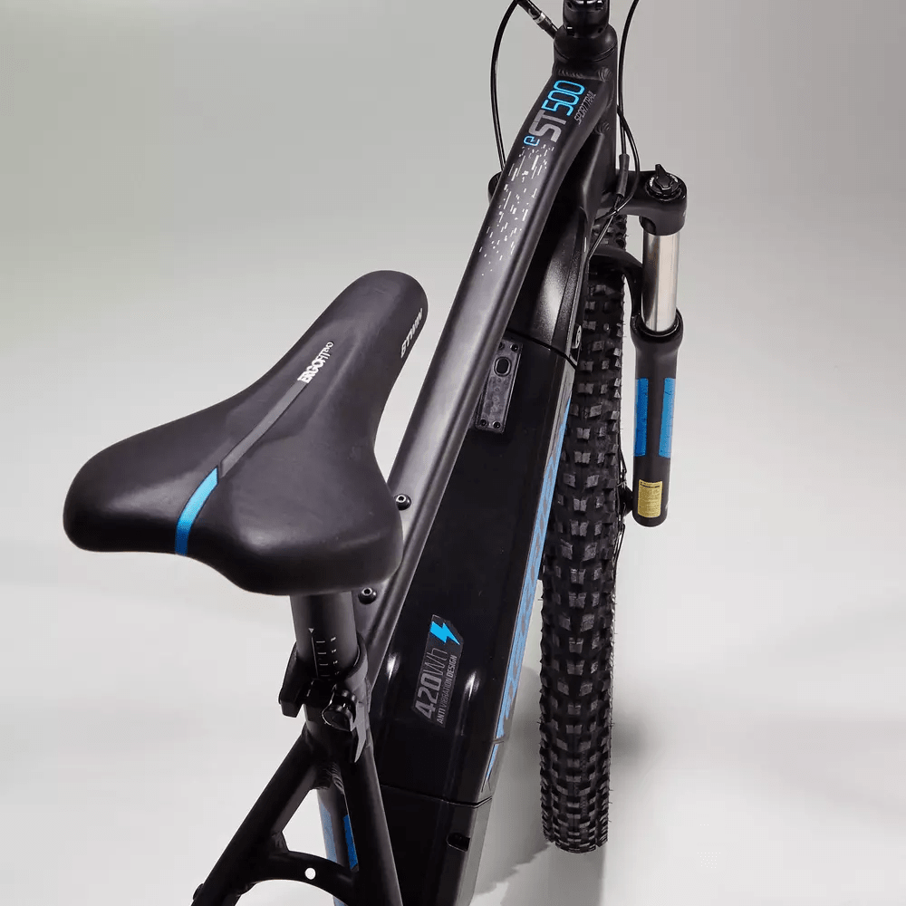
ERGONOMIC SADDLE

Slide 14

Developped in France

Slide 15
E-ST 500 V2 NOIR BLEU 27,5"
1199€
AVAILABLE NOW AT
Decathlon.fr

Slide 16
We recycle your old bike

